Slide 1



Reinforcement Learning
INTRODUCTION TO MACHINE LEARNING
- Ashwina Rakish

Slide 2
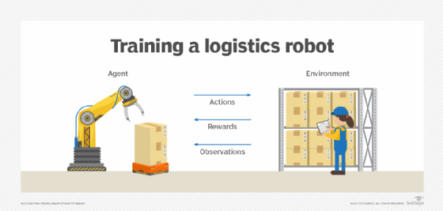
Reinforcement Learning
Reinforcement learning (RL) is a type of machine learning paradigm that deals with how an agent can learn to make sequential decisions by interacting with an environment. The fundamental idea behind reinforcement learning is to learn a policy(set of rules), in order to maximize the cumulative reward over time.

Slide 3
Key Terms in RL
1) Agent: The learner or decision-maker that interacts with the environment.
2) Environment: The external system with which the agent interacts.
3) State (s): A representation of the current situation of the environment. It's the input to the agent's decision-making process.
4) Action (a): The choices available to the agent at each state.
5) Policy (π): A strategy or rule that the agent follows to select actions.
6) Reward (r): A scalar feedback signal from the environment indicating how good or bad the action taken by the agent was.
7) Value function (V or Q): It predicts the expected cumulative reward the agent would receive starting from a certain state (or state-action pair) and following a particular policy.
The goal of the agent is to learn the optimal policy that maximizes cumulative rewards.

Slide 4
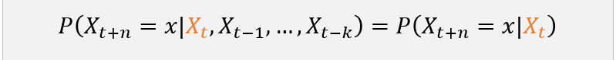
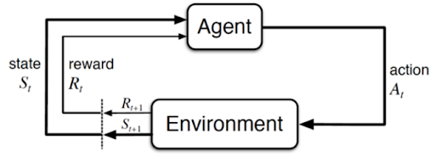
Markov Decision Process
A Markov Decision Process (MDP) is a mathematical framework used in reinforcement learning to model decision-making problems. It consists of states, actions, transition probabilities, and rewards. At each state, an agent takes an action, leading to a new state based on transition probabilities and receives a reward. Crucially, the next state depends only on the current state and action taken, adhering to the Markov property. MDPs help formalize the sequential decision-making process, enabling algorithms to find optimal policies that maximize cumulative rewards over time.

Slide 5
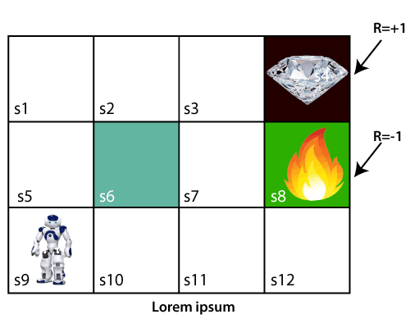
Q Learning
The Q-learning algorithm process is an interactive method where the agent learns by exploring the environment and updating the Q-table based on the rewards received. Q-learning is a model-free, value-based, off-policy algorithm that will find the best series of actions based on the agent's current state. The “Q” stands for quality. Quality represents how valuable the action is in maximizing future rewards.

Slide 6
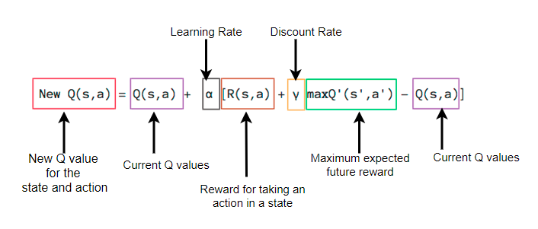
Bellman Equation for Q learning

Slide 7
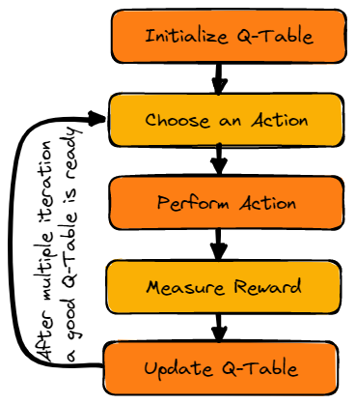
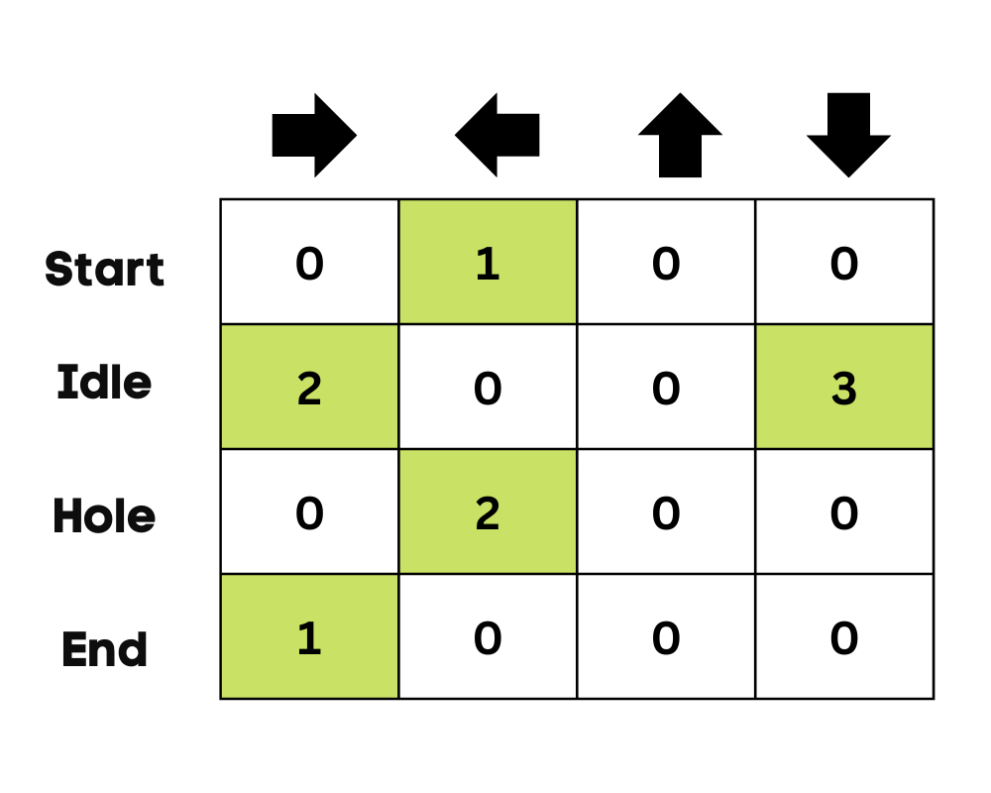
How does Q learning work?

Slide 8
QUIZ

Slide 9
Question: Is the data for an RL model labelled?
Answer: No, Only information about the environment may be fed. Dataset is not must.

Slide 10
Question: In the first few iterations, should there be more exploration or exploitation?
Answer: Exploration

Slide 11
Question: What would happen id a model always exploits?
Answer: Would miss out on a potentially better path.

Slide 12
Question: What would happen id a model always explores?
Answer: Will always choose a random path without utilizing the knowledge gained.

Slide 13
Question: What would happen if my discount rate is very small?
Answer: More importance is given to the immediate reward

Slide 14
Question: What if the discount rate is zero?
Answer: Q value becomes the immediate reward

Slide 15
Question: How much weightage will the future rewards be given if the discount rate is 1? A) Less than Immediate Reward B) More than Immediate Reward C) Same as Immediate Reward
Answer: C

Slide 16
Question: What would happen id the learning rate is 0?
Answer: Q values would not get updated

Slide 17
Thank You!

